Slide 1

BANK ACCOUNT MANAGEMENT SYSTEM
DBMS Project – Review I
Batch: 2025–2029 | II B.Tech – III Semester | AIML
Team Members
Y. J. Karthikeya
A. Prasanna Kumar
K. Prasanna Kumar
K. Murali Krishna

Slide 2

Introduction
Introduction
Banking systems manage large amounts of customer and transaction data.
Managing this information manually can be difficult and time-consuming.
A database helps store all banking information in an organized way.
Our project designs a database for managing:
Customers
Accounts
Transactions
Branches
Employees
Loans
Easy explanation: "Our project is a database designed to store and manage important banking information in one organized system."

Slide 3
Problem Statement
Traditional banking systems may involve:
Our Solution
Design a centralized database that stores banking information accurately and connects related records.
Multiple records for customer information
Difficulty in managing account details
Errors in transaction records
Difficulty in finding previous transactions
Problems maintaining branch, employee and loan information
Centralized Database - All banking data stored in one organized system
Data Relationships - Tables connected through primary and foreign keys to maintain accuracy
Easy Access & Reporting - Quick retrieval of customer, account, and transaction information
Error Prevention - Eliminates duplicate records and ensures data consistency

Slide 4

Objectives
Our database aims to:
Manage customer information
Manage branch and employee details
Create and manage bank accounts
Maintain loan information
Record deposits and withdrawals
Generate reports using SQL
Manage fund transfers
Maintain data accuracy using keys and constraints
Store transaction history
These are simplified directly from your original objectives.
Easy explanation: "The main goal is to manage all major banking activities through a structured database."

Slide 5






System Scope
Our system covers 6 major areas:
Customer
Branch
Transaction
→ Stores personal information, contact details, and customer identification data.
→ Maintains branch location, branch code, and office details.
→ Records deposits, withdrawals, transfers, dates, amounts, and transaction history.
Account
Employee
Loan
→ Tracks account types, account numbers, balances, and account status.
→ Stores staff records, designations, contact details, and branch assignments.
→ Manages loan types, loan amounts, interest rates, and customer loan records.
Easy explanation: "We divided our banking system into six major areas. Each area stores the data needed to manage that part of the bank."

Slide 6
Entities and Attributes
Entity
Attributes
Customer
Customer_ID, Name, Date_of_Birth, Gender, Phone, Email, Address
Account
Account_Number, Account_Type, Balance, Opening_Date, Customer_ID, Branch_ID, Account_Status
Branch
Branch_ID, Branch_Name, IFSC_Code, Address, City
Employee
Employee_ID, Employee_Name, Designation, Phone, Branch_ID
Transaction
Transaction_ID, Account_Number, Transaction_Type, Amount, Transaction_Date, Status
Loan
Loan_ID, Loan_Type, Loan_Amount, Interest_Rate, Customer_ID

Slide 7
Relationships Between Entities
Entity 1
Entity 2
Relationship
What it Means
Customer
Account
1:M
A single customer may hold multiple bank accounts.
Branch
Account
1:M
Each branch services many customer accounts.
Branch
Employee
1:M
Each branch has several employees assigned to it.
Account
Transaction
1:M
Every account can generate many transactions over time.
Customer
Loan
1:M
A customer may apply for and hold multiple loans.

Slide 8

Primary Keys & Foreign Keys
Keys in Our Database
Primary Key (PK)
Foreign Key (FK)
Uniquely identifies each record.
Examples:
Connects one table with another table.
Examples:
Customer_ID → Customer
Account_Number → Account
Branch_ID → Branch
Employee_ID → Employee
Transaction_ID → Transaction
Loan_ID → Loan
Customer_ID → Account
Branch_ID → Account
Branch_ID → Employee
Account_Number → Transaction
Customer_ID → Loan
Easy explanation: "A primary key identifies a record uniquely, while a foreign key connects two tables."

Slide 9

Relational Database Schema
Instead of putting complicated definitions, show the tables simply:
CUSTOMER
ACCOUNT
Customer_ID (PK)
Name
Phone
Email
Address
Account_Number (PK)
Account_Type
Balance
Customer_ID (FK)
Branch_ID (FK)
Account_Status
BRANCH
EMPLOYEE
Branch_ID (PK)
Branch_Name
IFSC_Code
Address
Employee_ID (PK)
Employee_Name
Designation
Branch_ID (FK)
TRANSACTION
LOAN
Transaction_ID (PK)
Account_Number (FK)
Transaction_Type
Amount
Transaction_Date
Loan_ID (PK)
Customer_ID (FK)
Loan_Type
Loan_Amount
Interest_Rate
Tip:
This slide should be mostly visual. Use six small boxes rather than paragraphs.
Simplified schema view shown for presentation clarity; complete attributes are defined in the Entity-Attribute table.

Slide 10
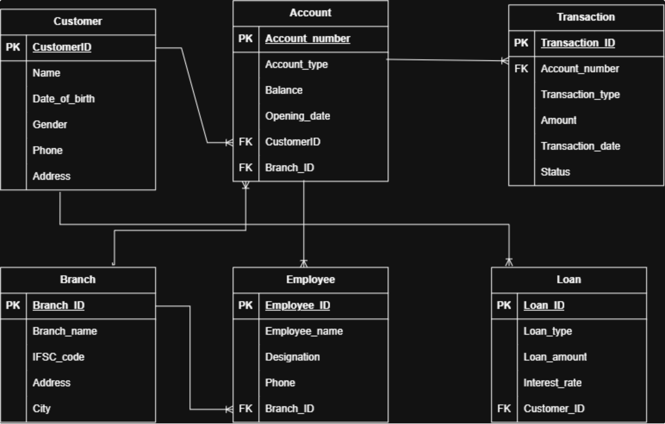
E-R Diagram
An E-R diagram is a visual model of a database.
It shows how data is organized and connected.
The main entities here include customer, account, branch, employee, transaction, and loan.
Relationships between entities are represented using primary keys and foreign keys.
This helps define the structure of the banking system clearly and accurately.

Slide 11
Team Contributions & Conclusion
Y. J. Karthikeya
A. Prasanna
K. Prasanna
K. Murali Krishna
Led the database design and helped define the tables, relationships, and overall structure.
Worked on the implementation part and helped build the bank account management system.
Supported testing and validation to make sure the database worked correctly and stored accurate records.
Prepared the documentation and helped present the project clearly and simply.
Conclusion
In this project, we created a bank account management database system that helps organize banking data in one place. It makes information easy to access, keeps records accurate, and supports smoother banking operations. By centralizing the data, the system solves the problem of scattered and hard-to-manage records. The proposed system provides a structured foundation for managing banking data and can be further enhanced with advanced banking features in future development.

